Slide 1

SOKOINE UNIVERSITY OF AGRICULTURE
Department of Informatics and Information Technology (DIIT)
BIT 111: MICROCOMPUTERS AND APPLICATIONS
TOPIC 4: FUNCTIONS AND TYPES OF OPERATING SYSTEMS
Official Undergraduate Lecture Slide Deck (Academic Year 2026/2027)
• Curriculum Coverage: OS Evolution & Categories (4.1) | DOS Commands (4.2) | GUI Management (4.3)
• Course Instructor: Madam Bertha Msuliche Lebalwa (MSc)
• Assessment Structure: 2 Assignments (5%), 2 Tests (15%), Practical Report (10%), Practical Test (30%), UE (40%)*
*Assessment weightings are subject to adjustment by the course instructor.
BIT 111: Microcomputers and Applications | Instructor: Madam Bertha Msuliche Lebalwa (MSc) - SUA Morogoro
Slide 1 of 42

Slide 2
BIT 111: MICROCOMPUTERS AND APPLICATIONS | SOKOINE UNIVERSITY OF AGRICULTURE
Topic 4: Lecture Outline & Learning Roadmap
Operating Systems, Process Management & Commands (Coverage: 4.1, 4.2, 4.3)
• Section 4.1: OS Evolution, Core Architecture & Subsystem Categories
- The OS as Extended Machine & Resource Arbiter; Kernel models (Monolithic, Microkernel, Hybrid)
- Dual-mode operation (Ring 0 vs Ring 3); System calls and interrupt handling
- Process management: PCB, 5-state lifecycle, CPU scheduling algorithms (FCFS, SJF, SRTF, RR)
- Memory management: Logical vs physical addressing, Paging, TLB, Virtual memory
- File systems: FAT32, NTFS, ext4; Allocation structures and Journaling
• Section 4.2: Disk Operating System (MS-DOS) Architecture & Commands
- DOS architecture: `IO.SYS`, `MSDOS.SYS`, `COMMAND.COM`
- Internal commands (`DIR`, `COPY`, `DEL`, `MD`, `CD`, `TYPE`) vs External (`FORMAT`, `CHKDSK`, `XCOPY`)
- Batch scripting (`.BAT`): Variables, parameters `%1-%9`, conditionals `IF`, loops `FOR`, redirection
• Section 4.3: Modern GUI Operating Systems (Windows & Linux) and Administration
- Windows architecture: Registry, Task Manager, Event Viewer, PowerShell cmdlets
- Linux architecture: Filesystem Hierarchy Standard (FHS), shell pipelines, process controls (`ps`, `top`, `kill`)
PEDAGOGICAL OBJECTIVE
Understand how the operating system bridges the gap between raw microprocessor silicon and user applications through process abstraction, resource scheduling, and command interfaces.
BIT 111: Microcomputers and Applications | Instructor: Madam Bertha Msuliche Lebalwa (MSc) - SUA Morogoro
Slide 2 of 42

Slide 3
BIT 111: MICROCOMPUTERS AND APPLICATIONS | SOKOINE UNIVERSITY OF AGRICULTURE
Topic 4: Intended Learning Outcomes (ILOs)
Core Operating Systems Competencies for SUA Undergraduates
• Explain the dual roles of an operating system: Extended Machine (Abstraction) and Resource Arbiter.
• Contrast Monolithic kernels, Microkernels, and Hybrid kernels in performance and fault isolation.
• Explain process states and compare operating-system scheduling approaches conceptually.
• Detail virtual memory address translation using the MMU, Page Tables, and TLB.
• Distinguish internal MS-DOS commands from external disk executables and write automated batch scripts.
• Evaluate file systems (FAT32, NTFS, ext4) regarding journaling, volume limits, and permissions.
• Execute administrative system commands in Windows (PowerShell) and Linux (Bash) environments.
BIT 111: Microcomputers and Applications | Instructor: Madam Bertha Msuliche Lebalwa (MSc) - SUA Morogoro
Slide 3 of 42

Slide 4
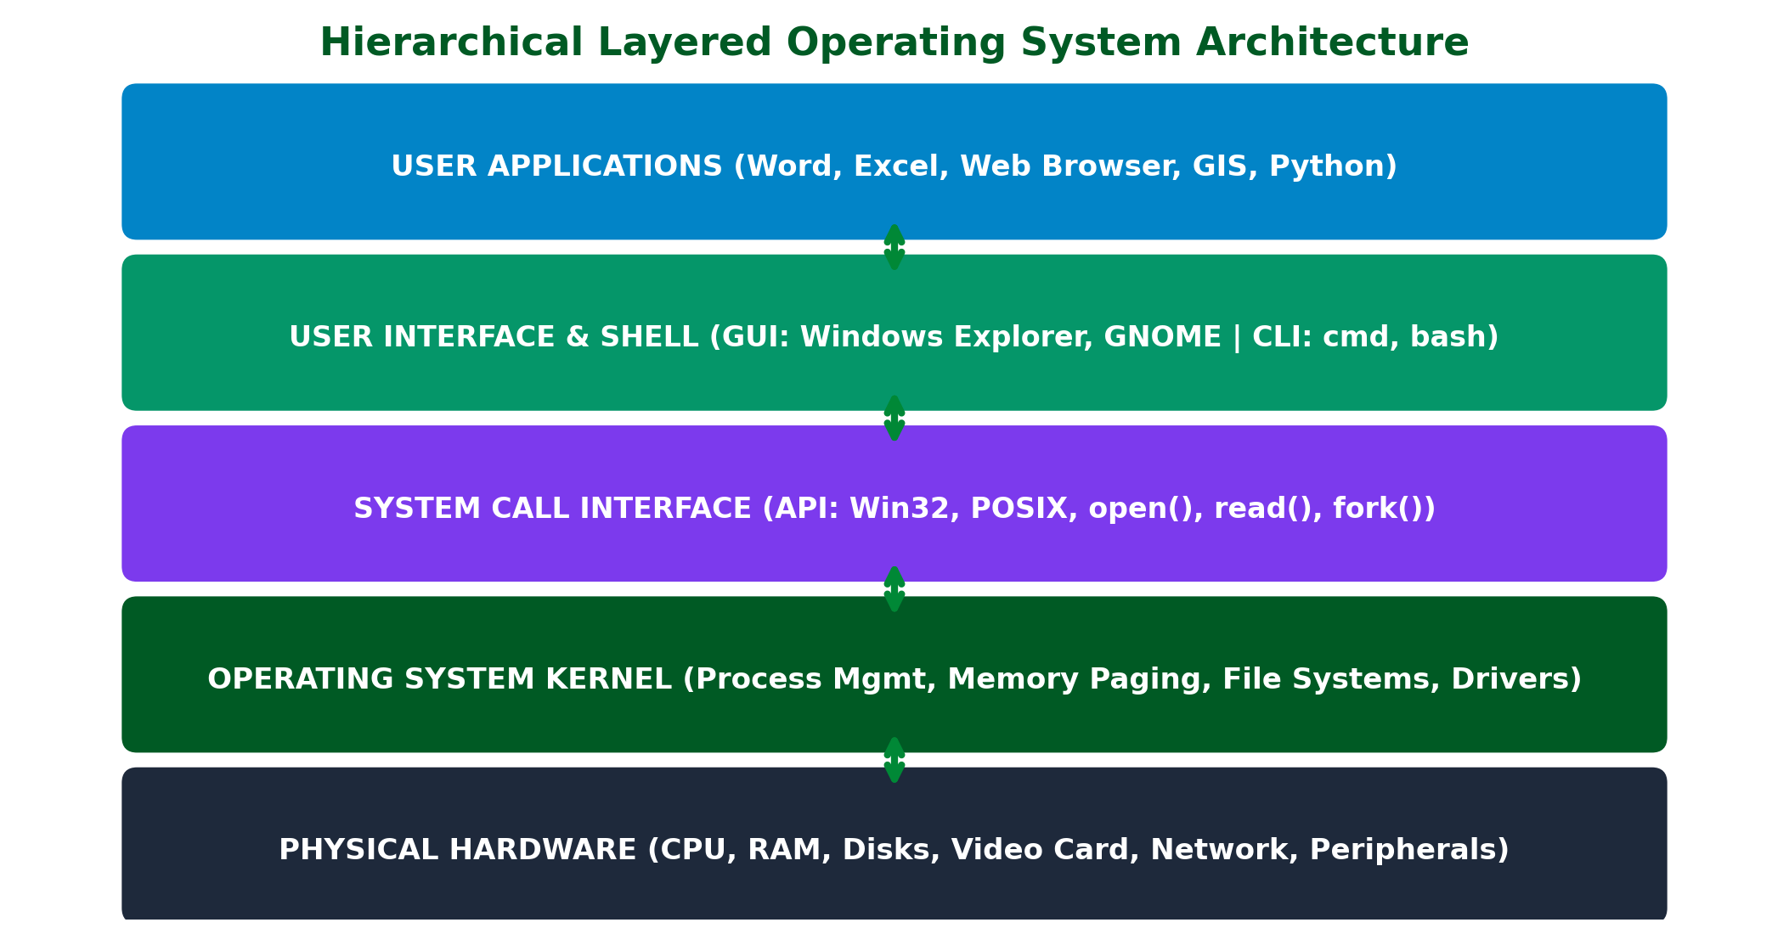
BIT 111: MICROCOMPUTERS AND APPLICATIONS | SOKOINE UNIVERSITY OF AGRICULTURE
Operating System Architectural Hierarchy
ARCHITECTURAL ANALYSIS & PRINCIPLES
• Hardware Layer: Physical CPU, memory, buses, timers, and peripheral controllers.
• Kernel Mode (Ring 0): Unrestricted hardware access executing process scheduling, memory allocation, and device drivers.
• System Call Interface: Protected software interrupt gate (e.g., `sys_enter`, `syscall`, `int 0x80`).
• User Mode (Ring 3): Sandboxed execution of user applications, shell CLI, and GUI desktop environments without direct hardware access.
Figure: The multi-tiered OS architectural model bridging hardware, kernel, system calls, and user applications.
BIT 111: Microcomputers and Applications | Instructor: Madam Bertha Msuliche Lebalwa (MSc) - SUA Morogoro
Slide 4 of 42

Slide 5
BIT 111: MICROCOMPUTERS AND APPLICATIONS | SOKOINE UNIVERSITY OF AGRICULTURE
OS Kernel Architectural Paradigms
Monolithic Kernels vs Microkernels vs Hybrid Models
• Monolithic Kernels (e.g., Linux, traditional UNIX):
- All core OS services (scheduler, memory manager, file systems, device drivers, network stack) run together in Ring 0.
- Advantage: Ultra-fast performance; direct function calls between subsystems.
- Disadvantage: A single buggy device driver can crash the entire operating system (Kernel Panic).
• Microkernels (e.g., Mach, QNX, seL4):
- Ring 0 stripped down to bare minimum: IPC (Inter-Process Communication), basic scheduling, low-level memory.
- Device drivers, file systems, and network stacks execute in User Space (Ring 3) as modular servers.
- Advantage: Extreme fault tolerance and security; crash of a driver does not crash the kernel.
• Hybrid Kernels (e.g., Windows NT kernel, Apple macOS XNU):
- Combines microkernel modularity with monolithic performance by keeping select drivers in kernel space.
BIT 111: Microcomputers and Applications | Instructor: Madam Bertha Msuliche Lebalwa (MSc) - SUA Morogoro
Slide 5 of 42

Slide 6
BIT 111: MICROCOMPUTERS AND APPLICATIONS | SOKOINE UNIVERSITY OF AGRICULTURE
Dual-Mode Operation & Hardware Protection
Preventing Errant User Programs from Crashing Microcomputers
• The Dual-Mode Protection Mechanism (enforced by CPU hardware status bit):
- 1. User Mode (Ring 3): Application execution mode; privileged CPU instructions (e.g., disabling interrupts, direct I/O port writes) are strictly forbidden.
- 2. Kernel / Supervisor Mode (Ring 0): Full instruction set enabled with direct hardware manipulation.
• System Calls (Syscalls): The sanctioned software API for user applications to request kernel services (e.g., `read()`, `write()`, `fork()`, `open()`).
• Mechanism: Application sets up arguments in registers, triggers a software trap/interrupt; CPU switches from Ring 3 to Ring 0, kernel validates parameters, executes task, and returns control switching back to Ring 3.
BIT 111: Microcomputers and Applications | Instructor: Madam Bertha Msuliche Lebalwa (MSc) - SUA Morogoro
Slide 6 of 42

Slide 7
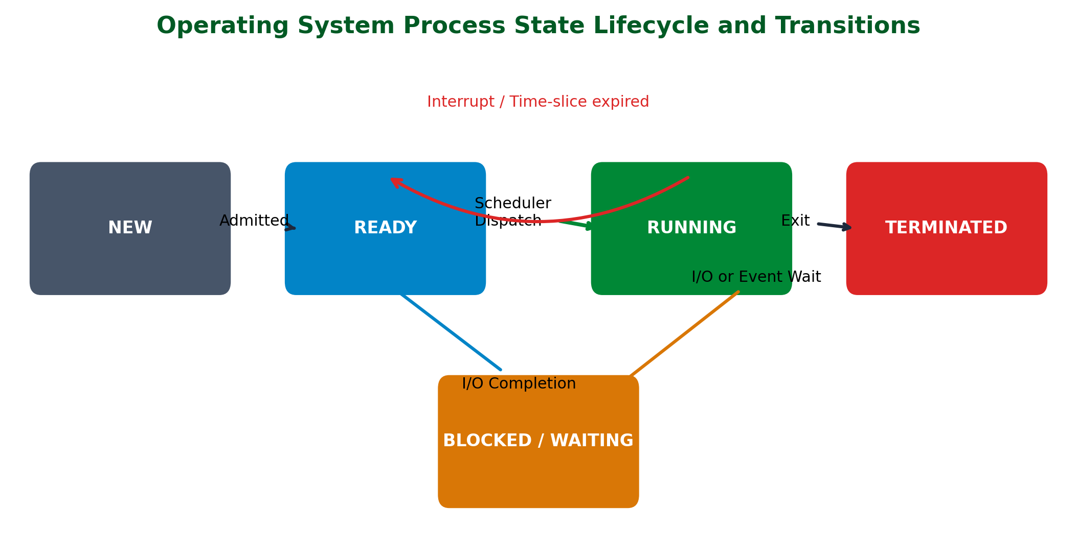
BIT 111: MICROCOMPUTERS AND APPLICATIONS | SOKOINE UNIVERSITY OF AGRICULTURE
The Five-State Process Lifecycle
ARCHITECTURAL ANALYSIS & PRINCIPLES
• New: Process being created and its Process Control Block (PCB) allocated.
• Ready: Process residing in main memory, waiting for the OS CPU scheduler to dispatch it.
• Running: Instructions currently executing on the physical CPU core.
• Waiting (Blocked): Process suspended waiting for an external event (disk I/O, keyboard input, network packet).
• Terminated: Process completed execution; resources deallocated by the kernel.
Figure: The classical 5-state process lifecycle illustrating CPU scheduling and I/O wait transitions.
BIT 111: Microcomputers and Applications | Instructor: Madam Bertha Msuliche Lebalwa (MSc) - SUA Morogoro
Slide 7 of 42

Slide 8
BIT 111: MICROCOMPUTERS AND APPLICATIONS | SOKOINE UNIVERSITY OF AGRICULTURE
Process Management & The Process Control Block (PCB)
The Kernel's Data Structure Representing a Living Process
• Process Definition: A program in execution; an active entity with a program counter, memory segments, and assigned OS resources.
• Process Control Block (PCB) Data Fields:
- Process Identifier (PID): Unique integer assigned by kernel.
- Process State: New, Ready, Running, Waiting, or Terminated.
- Program Counter (PC): Memory address of next instruction to execute.
- CPU Registers: Saved accumulator, index, stack pointer, and flag registers.
- CPU Scheduling Info: Process priority and queue pointers.
- Memory Management Info: Base/limit registers, page table pointers.
- Accounting & I/O Status: CPU time used, open file descriptors, allocated I/O devices.
• Context Switching: The CPU state save and restore cycle when preempting one process for another (pure computational overhead).
BIT 111: Microcomputers and Applications | Instructor: Madam Bertha Msuliche Lebalwa (MSc) - SUA Morogoro
Slide 8 of 42

Slide 9
BIT 111: MICROCOMPUTERS AND APPLICATIONS | SOKOINE UNIVERSITY OF AGRICULTURE
CPU Scheduling Approaches
How the operating system shares processor time
• The operating system chooses which ready process can use the processor.
• First-Come, First-Served runs processes in the order they arrive.
• Shortest Job First gives priority to work expected to finish sooner.
• Round Robin gives each ready process a brief turn in sequence and is useful for interactive systems.
• Scheduling approaches make different trade-offs between fairness, responsiveness, and simplicity.
BIT 111: Microcomputers and Applications | Instructor: Madam Bertha Msuliche Lebalwa (MSc) - SUA Morogoro
Slide 9 of 42

Slide 10
BIT 111: MICROCOMPUTERS AND APPLICATIONS | SOKOINE UNIVERSITY OF AGRICULTURE
Comparing Scheduling Approaches
A conceptual example from a shared computer lab
• In a shared laboratory, several users may open applications at the same time.
• First-Come, First-Served is simple to understand, but a long task can delay later tasks.
• Round Robin gives each ready process a turn, helping interactive applications remain responsive.
• A scheduling policy should balance responsiveness and fair access.
• Compare the approaches by describing their behavior; no timing calculations are required.
BIT 111: Microcomputers and Applications | Instructor: Madam Bertha Msuliche Lebalwa (MSc) - SUA Morogoro
Slide 10 of 42

Slide 11
BIT 111: MICROCOMPUTERS AND APPLICATIONS | SOKOINE UNIVERSITY OF AGRICULTURE
Concurrency, Race Conditions, and Deadlocks
Multi-Thread Synchronization and The Coffman Conditions
• Race Condition: A situation where multiple concurrent threads access shared data, and the final outcome depends on the non-deterministic timing of thread execution.
• Critical Section: Code segment accessing shared resources that must be executed with Mutual Exclusion (mutex locks, semaphores).
• Deadlock: A permanent stalling state where two or more processes are unable to proceed because each holds a resource the other needs.
• The Four Coffman Conditions (Must all hold simultaneously for deadlock):
1. Mutual Exclusion: At least one resource must be held in non-shareable mode.
2. Hold and Wait: A process holds resources while requesting additional ones.
3. No Preemption: Resources cannot be forcibly seized from a holding process.
4. Circular Wait: A closed chain of processes exists where P<sub>0</sub> waits for P<sub>1</sub>, and P<sub>n</sub> waits for P<sub>0</sub>.
BIT 111: Microcomputers and Applications | Instructor: Madam Bertha Msuliche Lebalwa (MSc) - SUA Morogoro
Slide 11 of 42

Slide 12
BIT 111: MICROCOMPUTERS AND APPLICATIONS | SOKOINE UNIVERSITY OF AGRICULTURE
Memory Management: Paging & Virtual Memory
Translating Virtual Addresses to Physical DRAM Frames
• Logical (Virtual) vs Physical Address Space: Applications operate in contiguous virtual memory isolated from actual fragmented physical RAM.
• Paging Mechanism: Divides virtual memory into fixed-size blocks called Pages (typically 4 KiB); physical memory divided into Frames of identical size.
• Memory Management Unit (MMU): Hardware on the CPU die translating virtual page numbers (VPN) to physical frame numbers (PFN) via Page Tables.
• Translation Lookaside Buffer (TLB): High-speed on-die associative cache buffering recent address translations, eliminating memory lookup overhead.
• Demand Paging & Page Faults: Pages loaded into DRAM only when accessed; referencing an unmapped page triggers a Page Fault interrupt, causing the OS to fetch the page from secondary storage (swap space).
BIT 111: Microcomputers and Applications | Instructor: Madam Bertha Msuliche Lebalwa (MSc) - SUA Morogoro
Slide 12 of 42

Slide 13
BIT 111: MICROCOMPUTERS AND APPLICATIONS | SOKOINE UNIVERSITY OF AGRICULTURE
Enterprise File Systems Comparison
Feature / Attribute | FAT32 | exFAT | NTFS | ext4 (Linux)
Max File Size | 4 GiB | 16 EiB | 16 TiB - 8 PiB | 16 TiB
Max Volume Size | 2 TiB (32-bit) | 128 PiB | 8 PiB | 1 EiB
Journaling Support | No (Corruption prone) | No | Yes (USN Journal) | Yes (JBD2 Journal)
Access Control (ACLs) | None (Universal read) | None | Full NTFS Permissions | Full POSIX Permissions
Native Encryption | None | None | EFS (Encrypting FS) | fscrypt (Native)
Target Ecosystem | Legacy USB Drives | Cross-Platform Flash | Windows OS & Servers | Linux OS & Servers
BIT 111: Microcomputers and Applications | Instructor: Madam Bertha Msuliche Lebalwa (MSc) - SUA Morogoro
Slide 13 of 42

Slide 14
BIT 111: MICROCOMPUTERS AND APPLICATIONS | SOKOINE UNIVERSITY OF AGRICULTURE
MS-DOS Architecture: Three Core Files
The 16-Bit Real-Mode Disk Operating System
• Historical Significance: 16-bit single-user, single-tasking command-line OS created by Tim Paterson (86-DOS) and licensed by Microsoft as MS-DOS / PC-DOS (1981).
• The Three Fundamental System Files:
- 1. `IO.SYS`: Low-level hardware interface containing basic device drivers (screen, keyboard, serial, floppy); interfaces directly with ROM BIOS.
- 2. `MSDOS.SYS`: The DOS operating system kernel; manages the file system, memory allocation, directory structures, and system call interrupts (`INT 21h`).
- 3. `COMMAND.COM`: The default command-line command interpreter (shell); parses user commands, executes batch files, and houses all internal commands.
• Boot Sequence: ROM BIOS POST → MBR → Boot Sector → Loads `IO.SYS` → Loads `MSDOS.SYS` → Parses `CONFIG.SYS` → Executes `COMMAND.COM` → Runs `AUTOEXEC.BAT`.
BIT 111: Microcomputers and Applications | Instructor: Madam Bertha Msuliche Lebalwa (MSc) - SUA Morogoro
Slide 14 of 42

Slide 15
BIT 111: MICROCOMPUTERS AND APPLICATIONS | SOKOINE UNIVERSITY OF AGRICULTURE
MS-DOS Internal Commands
Resident in RAM: Handled Directly by COMMAND.COM
• Definition: Built directly into `COMMAND.COM`; always resident in main memory, executing instantly without requiring disk access.
• Essential Internal Directory & File Commands:
- `DIR`: Lists files, subdirectories, file sizes, and timestamps in current directory.
- `MD` or `MKDIR`: Creates a new subdirectory (e.g., `MD D:\SUA_DATA`).
- `CD` or `CHDIR`: Changes the current working directory (e.g., `CD \ACADEMIC\BIT111`).
- `RD` or `RMDIR`: Removes an empty directory.
- `COPY`: Copies one or more files to another destination (e.g., `COPY notes.txt E:\`).
- `DEL` or `ERASE`: Deletes specified files from the disk.
- `REN`: Renames files or directories without moving them.
- `TYPE`: Displays contents of a text file on the screen.
- `CLS`: Clears the display screen; `VER`: Displays operating system version.
BIT 111: Microcomputers and Applications | Instructor: Madam Bertha Msuliche Lebalwa (MSc) - SUA Morogoro
Slide 15 of 42

Slide 16
BIT 111: MICROCOMPUTERS AND APPLICATIONS | SOKOINE UNIVERSITY OF AGRICULTURE
MS-DOS External Commands
Disk-Resident Executables: Stored as .COM, .EXE, or .BAT Files
• Definition: Separate executable files stored on secondary storage; loaded into RAM only when invoked by the user.
• Essential External Disk & File Management Commands:
- `FORMAT.COM`: Formats a disk volume with a file system, creating the boot sector, FAT tables, and root directory.
- `CHKDSK.EXE`: Analyzes disk volume integrity, checks for lost allocation clusters, and reports free/bad sectors.
- `XCOPY.EXE`: Advanced file/directory copy utility supporting recursive directory tree copying (`/S /E /Y /V`).
- `ROBOCOPY.EXE` (Modern Windows): Robust file copying utility with multi-threading, restartable mode, and mirror synchronization.
- `ATTRIB.EXE`: Views or modifies file attributes: Read-only (`+R`), Hidden (`+H`), System (`+S`), Archive (`+A`).
- `TREE.COM`: Graphically displays directory path hierarchy of a drive.
BIT 111: Microcomputers and Applications | Instructor: Madam Bertha Msuliche Lebalwa (MSc) - SUA Morogoro
Slide 16 of 42

Slide 17
BIT 111: MICROCOMPUTERS AND APPLICATIONS | SOKOINE UNIVERSITY OF AGRICULTURE
MS-DOS Batch Scripting & Automation
Automating Multi-Step Operations via .BAT Files
• Batch File: Plain text file containing sequential DOS commands executed by `COMMAND.COM` or Windows `cmd.exe`.
• Key Syntax Elements:
- `@ECHO OFF`: Suppresses command echoing to clean up terminal output.
- Command-line arguments: Positional variables `%1`, `%2`, through `%9`.
- Conditionals: `IF EXIST filename (command) ELSE (command)`.
- Flow Control: `GOTO label` and `:label` definitions.
- Iteration: `FOR %%F IN (*.DAT) DO (command)`.
- Redirection Operators: Output redirect `>` (overwrite), `>>` (append), Input redirect `<`, Pipe `|`.
BIT 111: Microcomputers and Applications | Instructor: Madam Bertha Msuliche Lebalwa (MSc) - SUA Morogoro
Slide 17 of 42

Slide 18
BIT 111: MICROCOMPUTERS AND APPLICATIONS | SOKOINE UNIVERSITY OF AGRICULTURE
Modern GUI Operating Systems: The WIMP Paradigm
Windows, Icons, Menus, and Pointer Interfaces
• Evolution from CLI to GUI: Douglas Engelbart (NLS, 1968) → Xerox PARC (Alto, 1973) → Apple Macintosh (1984) → Windows 95.
• WIMP Elements:
- Windows: Rectangular screen viewports isolating running application contexts.
- Icons: Small graphical pictograms representing files, programs, and system entities.
- Menus: Drop-down or context-sensitive lists of executable options.
- Pointer: Mouse/trackpad cursor translating physical 2D hand movement into on-screen spatial targeting.
• Modern Desktop Environments: Windows Shell / Fluent Design; Linux GNOME, KDE Plasma, XFCE.
BIT 111: Microcomputers and Applications | Instructor: Madam Bertha Msuliche Lebalwa (MSc) - SUA Morogoro
Slide 18 of 42

Slide 19
BIT 111: MICROCOMPUTERS AND APPLICATIONS | SOKOINE UNIVERSITY OF AGRICULTURE
Windows System Management Utilities
Core MMC Consoles and Administrative Tools
• Task Manager (`taskmgr`): Inspects running processes, CPU/RAM/Disk utilization, startup programs, and thread status.
• Device Manager (`devmgmt.msc`): Hardware abstraction console displaying driver versions, IRQ assignments, and hardware device conflicts.
• Disk Management (`diskmgmt.msc`): Initializes MBR/GPT partition tables, shrinks/extends volumes, formats NTFS/exFAT drives.
• Event Viewer (`eventvwr.msc`): Centralized diagnostic log repository recording Application, Security, Setup, and System error logs.
• Services MMC (`services.msc`): Controls background daemon processes (Start, Stop, Restart, Startup Type: Auto/Manual/Disabled).
• Windows Registry (`regedit`): Hierarchical database storing OS configuration (`HKEY_LOCAL_MACHINE`, `HKEY_CURRENT_USER`).
BIT 111: Microcomputers and Applications | Instructor: Madam Bertha Msuliche Lebalwa (MSc) - SUA Morogoro
Slide 19 of 42

Slide 20
BIT 111: MICROCOMPUTERS AND APPLICATIONS | SOKOINE UNIVERSITY OF AGRICULTURE
Modern Windows Administration: PowerShell
Object-Oriented Automation vs Traditional Text Shells
• Paradigm Shift: Unlike traditional text-based shells (DOS/Bash), PowerShell passes structured .NET objects across the pipeline, not raw character streams.
• Verb-Noun Syntax: Consistent command naming pattern (`Get-Service`, `Stop-Process`, `Set-ExecutionPolicy`).
• Essential Administrative Cmdlets:
- `Get-Process | Where-Object WorkingSet -gt 500MB | Stop-Process`: Kills processes consuming >500 MB RAM.
- `Get-Service -Name Spooler | Restart-Service`: Restarts print spooler daemon.
- `Get-EventLog -LogName System -EntryType Error -Newest 10`: Extracts latest 10 critical system errors.
- `Test-NetConnection -ComputerName www.sua.ac.tz -Port 443`: Verifies TCP socket reachability.
BIT 111: Microcomputers and Applications | Instructor: Madam Bertha Msuliche Lebalwa (MSc) - SUA Morogoro
Slide 20 of 42

Slide 21
BIT 111: MICROCOMPUTERS AND APPLICATIONS | SOKOINE UNIVERSITY OF AGRICULTURE
Linux Architecture & Filesystem Hierarchy Standard
The Structure of the Enterprise Open-Source OS
• Philosophy: 'Everything is a file' — storage devices, serial ports, and processes are exposed via virtual filesystems.
• FHS Directory Hierarchy:
- `/bin` & `/sbin`: Essential user and system administration binary executables.
- `/etc`: System-wide configuration files (e.g., `/etc/passwd`, `/etc/fstab`, `/etc/network`).
- `/home`: User personal directories and application data.
- `/var`: Variable data files (log files in `/var/log`, mail spools, web root `/var/www`).
- `/dev`: Special device nodes representing hardware (`/dev/sda`, `/dev/nvme0n1`).
- `/proc` & `/sys`: Virtual pseudo-filesystems exposing live kernel state and hardware metrics.
BIT 111: Microcomputers and Applications | Instructor: Madam Bertha Msuliche Lebalwa (MSc) - SUA Morogoro
Slide 21 of 42

Slide 22
BIT 111: MICROCOMPUTERS AND APPLICATIONS | SOKOINE UNIVERSITY OF AGRICULTURE
Linux Terminal Diagnostics & Process Control
Inspecting System Performance and Managing Daemons
• Process Inspection: `ps aux` (BSD syntax), `ps -ef` (System V syntax), `top`, `htop` (interactive ncurses monitor).
• Signal Transmission: `kill -15 PID` (SIGTERM - polite termination request allowing cleanup) vs `kill -9 PID` (SIGKILL - immediate uninterceptable kernel abort).
• Process Scheduling Priority: `nice -n 10 command` (launches process with lower CPU priority); `renice -n -5 -p PID` (boosts running process priority).
• Service Management via systemd: `systemctl status service_name`, `systemctl start/stop/restart`, `systemctl enable` (auto-start on boot).
• Storage Telemetry: `df -h` (filesystem disk space usage), `du -sh /path` (directory space consumption).
BIT 111: Microcomputers and Applications | Instructor: Madam Bertha Msuliche Lebalwa (MSc) - SUA Morogoro
Slide 22 of 42

Slide 23
BIT 111: MICROCOMPUTERS AND APPLICATIONS | SOKOINE UNIVERSITY OF AGRICULTURE
Real-Time Operating Systems (RTOS) in Agriculture
Deterministic Guarantees vs Best-Effort Desktop Systems
• RTOS Definition: An operating system designed to execute processes within strictly bounded, deterministic time constraints (deadlines).
• Categories:
- Hard Real-Time: Missing a single deadline is considered total system failure (e.g., autonomous tractor obstacle avoidance, airbag deployment).
- Soft Real-Time: Missing a deadline degrades quality of service but does not cause catastrophic system failure (e.g., video streaming telemetry).
• Why GPOS (Windows/Ubuntu) Fails at Real-Time: Non-deterministic kernel preemption latency, complex virtual memory page faults, and background garbage collection.
• Agricultural Harvester Case Study: High-speed optical grain sorters use RTOS (e.g., FreeRTOS, VxWorks) to actuate pneumatic air-ejector valves in < 2 ms when rejecting discolored grains.
BIT 111: Microcomputers and Applications | Instructor: Madam Bertha Msuliche Lebalwa (MSc) - SUA Morogoro
Slide 23 of 42

Slide 24
BIT 111: MICROCOMPUTERS AND APPLICATIONS | SOKOINE UNIVERSITY OF AGRICULTURE
OS Boot Architecture: Firmware to Init / Systemd (PID 1)
The Step-by-Step Transition from Silicon to Multi-User Shell
• Boot Sequence Stages:
1. POST & Firmware: UEFI initializes hardware, verifies CPU/RAM, executes Secure Boot validation.
2. Bootloader: UEFI executes EFI bootloader (GRUB2 on Linux / Windows Boot Manager `bootmgr.efi`).
3. Kernel Initialization: Kernel decompressed into RAM, sets up page tables, MMU, interrupts, device drivers.
4. Root Filesystem Mount: Mounts initial RAM disk (`initramfs`) to load storage drivers, then mounts real root `/`.
5. Init / Systemd (PID 1): The ancestor process of all user-space daemons, launching target services (networking, SSH, display manager).
• Windows Equivalent: `ntoskrnl.exe` initialized → launches Session Manager Subsystem (`smss.exe`) → launches `csrss.exe` and `wininit.exe`.
BIT 111: Microcomputers and Applications | Instructor: Madam Bertha Msuliche Lebalwa (MSc) - SUA Morogoro
Slide 24 of 42

Slide 25
BIT 111: MICROCOMPUTERS AND APPLICATIONS | SOKOINE UNIVERSITY OF AGRICULTURE
Page Replacement Algorithms: FIFO to LRU and Clock
Managing Limited Physical Memory Under Heavy Workloads
• The Page Replacement Problem: When a page fault occurs and all DRAM frames are occupied, the OS must evict a victim page to secondary storage.
• 1. First-In, First-Out (FIFO): Evicts the oldest loaded page; simple queue; suffers from Belady's Anomaly (allocating more physical frames can paradoxically increase page faults).
• 2. Optimal Page Replacement (OPT / MIN): Evicts the page that will not be used for the longest future duration; theoretically optimal but impossible to implement in practice (requires future knowledge).
• 3. Least Recently Used (LRU): Evicts the page unused for the longest past time (approximates OPT based on temporal locality); high overhead to track timestamps.
• 4. Clock Algorithm (Second-Chance): Practical approximation of LRU using a single reference bit per frame scanned circularly by a clock pointer.
BIT 111: Microcomputers and Applications | Instructor: Madam Bertha Msuliche Lebalwa (MSc) - SUA Morogoro
Slide 25 of 42

Slide 26
BIT 111: MICROCOMPUTERS AND APPLICATIONS | SOKOINE UNIVERSITY OF AGRICULTURE
Virtual Memory Thrashing & The Working Set Model
Understanding System Freezes Caused by Paging Collapse
• Thrashing Definition: A state where the CPU spends more time swapping pages between RAM and disk than executing real user instructions.
• The Collapse Mechanism: If the sum of working sets of all running processes exceeds total physical RAM, page fault frequency skyrockets → CPU utilization plummets to near zero → OS scheduler misinterprets low CPU usage and launches more processes, worsening the collapse.
• Working Set Model (Peter Denning):
- Working Set W(t, Δ): The set of pages referenced by a process in the most recent time window Δ.
- Operating System Policy: The OS must ensure that each process has enough frames allocated to hold its working set. If total demand exceeds physical memory, the OS suspends (swaps out) entire processes to restore equilibrium.
BIT 111: Microcomputers and Applications | Instructor: Madam Bertha Msuliche Lebalwa (MSc) - SUA Morogoro
Slide 26 of 42

Slide 27
BIT 111: MICROCOMPUTERS AND APPLICATIONS | SOKOINE UNIVERSITY OF AGRICULTURE
File Allocation Architecture: Inodes & Extents
Contiguous, Linked List, and Indexed File Block Mapping
• 1. Contiguous Allocation: File blocks stored in sequential disk sectors; fast sequential access; severe external fragmentation; difficult file expansion.
• 2. Linked List Allocation: Each disk block contains a pointer to the next block; eliminates external fragmentation; slow random access; pointer corruption destroys remaining file.
• 3. Indexed Allocation (UNIX Inode Architecture):
- Inode: Metadata structure containing file size, permissions, timestamps, and an array of block pointers.
- Direct Pointers (typically 12): Point directly to data blocks (fast access for small files).
- Indirect Pointers: Single, Double, and Triple indirect pointers pointing to pointer tables, allowing files to scale to terabytes.
• Modern Extent-Based Allocation: Extents (start block + length) used in ext4 and NTFS to reduce pointer overhead for large contiguous files.
BIT 111: Microcomputers and Applications | Instructor: Madam Bertha Msuliche Lebalwa (MSc) - SUA Morogoro
Slide 27 of 42

Slide 28
BIT 111: MICROCOMPUTERS AND APPLICATIONS | SOKOINE UNIVERSITY OF AGRICULTURE
Hypervisors & Virtualization: Type-1 vs Type-2
Hardware Abstraction and Multi-Tenant Server Consolidation
• Virtual Machine (VM): Complete software emulation of an entire physical computer, including virtual CPU, virtual BIOS/UEFI, virtual RAM, and virtual storage.
• Type-1 Hypervisor (Bare-Metal):
- Installs and runs directly on bare physical server hardware (e.g., VMware ESXi, Proxmox VE, Microsoft Hyper-V Server, KVM).
- Superior performance, low virtualization latency, high security isolation; the enterprise standard for university cloud datacenters.
• Type-2 Hypervisor (Hosted):
- Runs as an application inside an existing host operating system (e.g., Oracle VirtualBox, VMware Workstation).
- Dependent on host OS stability; used primarily for student labs, testing, and cross-platform software development.
BIT 111: Microcomputers and Applications | Instructor: Madam Bertha Msuliche Lebalwa (MSc) - SUA Morogoro
Slide 28 of 42

Slide 29
BIT 111: MICROCOMPUTERS AND APPLICATIONS | SOKOINE UNIVERSITY OF AGRICULTURE
Containerization: Linux Namespaces & Docker vs VMs
Operating System-Level Virtualization and Microservices
• Paradigm Difference: While Virtual Machines virtualize the underlying physical hardware, Containers virtualize the operating system kernel.
• Linux Kernel Foundations of Containers:
- Namespaces: Isolate process visibility across PID (process IDs), NET (network interfaces/ports), MNT (filesystem mounts), and IPC.
- Control Groups (cgroups): Restrict and measure resource consumption (limiting container CPU cores, memory limits, I/O bandwidth).
• Container Advantages over VMs:
- Near-Zero Boot Time: Boots in milliseconds (just launching a sandboxed process, not booting an entire OS kernel).
- Featherweight Footprint: Shares host kernel; container images often < 100 MB vs 20+ GB for a VM disk image.
- Portability: Docker packages agricultural AI scripts with exact Python dependencies for uniform execution.
BIT 111: Microcomputers and Applications | Instructor: Madam Bertha Msuliche Lebalwa (MSc) - SUA Morogoro
Slide 29 of 42

Slide 30
BIT 111: MICROCOMPUTERS AND APPLICATIONS | SOKOINE UNIVERSITY OF AGRICULTURE
Linux Storage Management: Logical Volume Manager (LVM)
Dynamic Partitioning and Online Storage Resizing
• The Static Partition Limitation: Traditional MBR/GPT partitions have fixed sizes; resizing requires unmounting filesystems and risks data loss.
• LVM Architectural Layers:
- Physical Volumes (PV): Raw physical partitions or entire disks initialized for LVM (`pvcreate /dev/sdb1`).
- Volume Groups (VG): Storage pools created by aggregating multiple PVs into a unified storage pool (`vgcreate data_pool /dev/sdb1 /dev/sdc1`).
- Logical Volumes (LV): Virtual partitions carved out of the Volume Group, formatted with a filesystem (ext4/XFS) and mounted (`lvcreate -L 50G -n crop_docs data_pool`).
• Key Benefits: Online volume expansion (`lvextend -L +20G /dev/data_pool/crop_docs -r`) and atomic read-only storage snapshots for backup.
BIT 111: Microcomputers and Applications | Instructor: Madam Bertha Msuliche Lebalwa (MSc) - SUA Morogoro
Slide 30 of 42

Slide 31
BIT 111: MICROCOMPUTERS AND APPLICATIONS | SOKOINE UNIVERSITY OF AGRICULTURE
Shell I/O Redirection & Pipeline Diagnostics
Composing Modular Terminal Tools via Standard Streams
• The Three Standard POSIX Streams:
- Standard Input (`stdin`, File Descriptor `0`): Keyboard input by default.
- Standard Output (`stdout`, File Descriptor `1`): Terminal screen display.
- Standard Error (`stderr`, File Descriptor `2`): Unbuffered diagnostic error messages.
• Redirection Operators:
- `command > file.txt`: Redirects `stdout`, overwriting file.
- `command >> file.txt`: Redirects `stdout`, appending to file.
- `command 2> errors.log`: Redirects only `stderr` to file.
- `command &> all_output.log`: Redirects both `stdout` and `stderr`.
• Pipelines (`|`): Passes `stdout` of left command directly as `stdin` of right command:
- Example: `ps aux | grep python3 | awk '{print $2, $4}' | sort -nr`.
BIT 111: Microcomputers and Applications | Instructor: Madam Bertha Msuliche Lebalwa (MSc) - SUA Morogoro
Slide 31 of 42

Slide 32
BIT 111: MICROCOMPUTERS AND APPLICATIONS | SOKOINE UNIVERSITY OF AGRICULTURE
Topic 4: Key Takeaways & Synthesis Matrix
Summary of Operating Systems Principles for Academic Mastery
• OS Foundations: Resource Arbiter and Extended Machine; Kernel Mode (Ring 0) protects hardware from User Mode (Ring 3).
• Kernels: Monolithic (fast, single address space) vs Microkernel (modular, IPC-based, isolated drivers).
• Process Scheduling: Managed through process information; algorithms differ in order, fairness, and responsiveness.
• Memory & Storage: Paging enables virtual memory via MMU/TLB; Journaling (NTFS/ext4) prevents metadata corruption during sudden power cuts.
• MS-DOS: Driven by `IO.SYS`, `MSDOS.SYS`, and `COMMAND.COM`; internal commands resident in RAM, external commands on disk.
• Systems Administration: Windows leverages PowerShell object pipelines; Linux leverages Bash text streams and FHS hierarchy.
BIT 111: Microcomputers and Applications | Instructor: Madam Bertha Msuliche Lebalwa (MSc) - SUA Morogoro
Slide 32 of 42

Slide 33
BIT 111: MICROCOMPUTERS AND APPLICATIONS | SOKOINE UNIVERSITY OF AGRICULTURE
Review Quiz & Knowledge Check
Self-Testing Key OS Concepts
1. Why is an operating system's kernel executed in Ring 0 while user web browsers execute in Ring 3?
2. What is the fundamental difference between an Internal DOS command and an External DOS executable?
3. Explain how a Journaling file system (such as ext4 or NTFS) prevents volume corruption when power fails.
4. What causes process 'Starvation' in Shortest Remaining Time First (SRTF) CPU scheduling?
5. Why is a standard desktop Linux or Windows OS unsuitable for hard real-time tractor guidance controls?
BIT 111: Microcomputers and Applications | Instructor: Madam Bertha Msuliche Lebalwa (MSc) - SUA Morogoro
Slide 33 of 42

Slide 34
BIT 111: MICROCOMPUTERS AND APPLICATIONS | SOKOINE UNIVERSITY OF AGRICULTURE
Reading Assignments & Homework Notice
Preparation for Next Lecture & Continuous Assessment
• Required Readings:
- Silberschatz, A., Galvin, P. B., & Gagne, G. - Operating System Concepts (10th ed.). Wiley. https://www.wiley.com/en-ie/Operating+System+Concepts%2C+10th+Edition-p-9781119320913
- Smith, J. L., Wang, S., & Mortati, J. - Information Systems for Business and Beyond (2019), Chapter 3: Software. https://opentextbook.site/informationsystems2019/
• Homework Assignment 4 Notice:
- Available on SUA Moodle / Assignment directory: `BIT_111_Assignment_4.pdf`.
- Total Allocation: 100 Marks (Covers Process Scheduling, Batch Scripting, and Administrative Utilities).
- Submission Deadline: End of Week 8 by 17:00 EAT.
• Next Lecture Preview: Topic 5 — Microcomputer Applications (Word Processing, Simple Spreadsheets, Internet Protocols).
BIT 111: Microcomputers and Applications | Instructor: Madam Bertha Msuliche Lebalwa (MSc) - SUA Morogoro
Slide 34 of 42

Slide 35
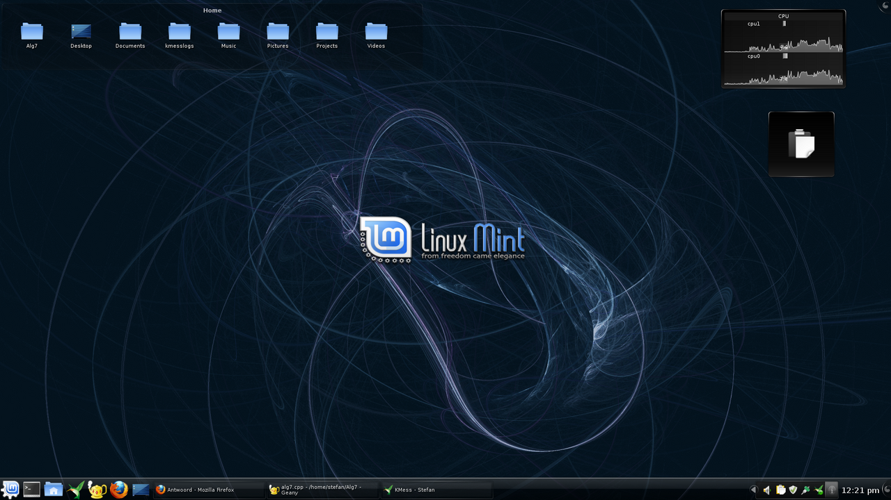
BIT 111: MICROCOMPUTERS AND APPLICATIONS | SOKOINE UNIVERSITY OF AGRICULTURE
Topic 4: Desktop Linux Mint 9 KDE.png
IMAGE NOTES
Description: Desktop Linux Mint 9 KDE
Creator: SteefuitHeerlen
License: CC BY 3.0
Source: Wikimedia Commons file page
License details
BIT 111: Microcomputers and Applications | Instructor: Madam Bertha Msuliche Lebalwa (MSc) - SUA Morogoro
Slide 35 of 42

Slide 36
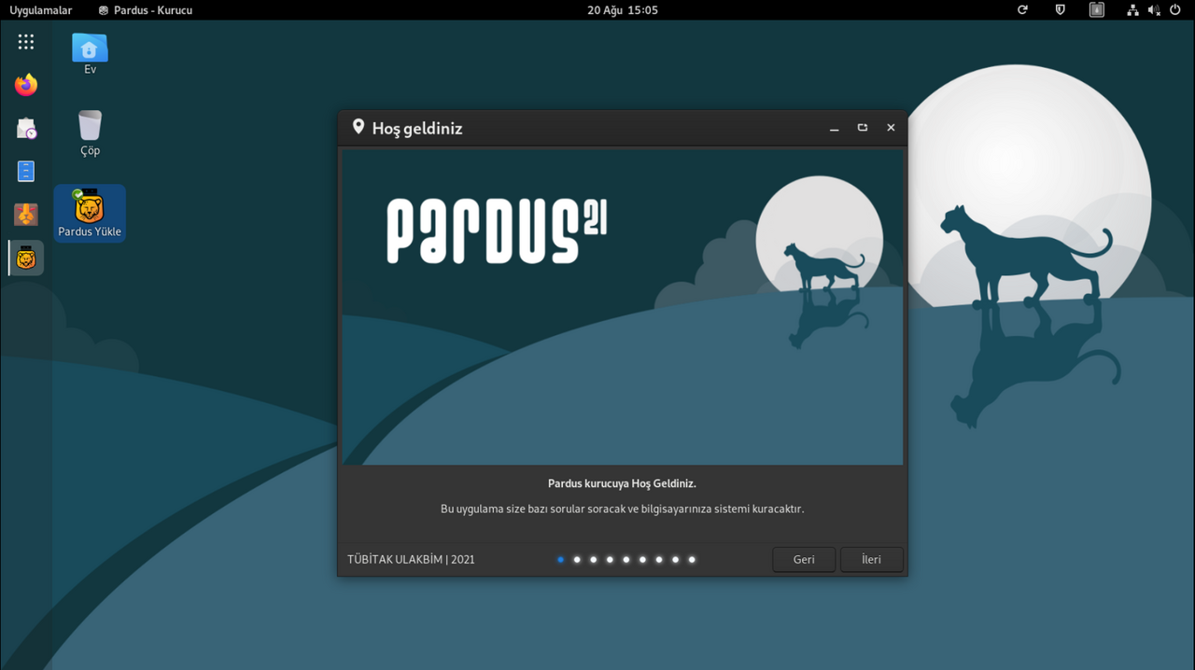
BIT 111: MICROCOMPUTERS AND APPLICATIONS | SOKOINE UNIVERSITY OF AGRICULTURE
Topic 4: Ekran görüntüsü 2021-08-20 15-05-42.png
IMAGE NOTES
Description: Ekran görüntüsü 2021-08-20 15-05-42
Creator: AliIsingor
License: CC BY-SA 4.0
Source: Wikimedia Commons file page
License details
BIT 111: Microcomputers and Applications | Instructor: Madam Bertha Msuliche Lebalwa (MSc) - SUA Morogoro
Slide 36 of 42

Slide 37

BIT 111: MICROCOMPUTERS AND APPLICATIONS | SOKOINE UNIVERSITY OF AGRICULTURE
Topic 4: Linux-Mint-MATE-20-desktop.png
IMAGE NOTES
Description: Linux-Mint-MATE-20-desktop
Creator: Michal Stanke
License: CC BY-SA 4.0
Source: Wikimedia Commons file page
License details
BIT 111: Microcomputers and Applications | Instructor: Madam Bertha Msuliche Lebalwa (MSc) - SUA Morogoro
Slide 37 of 42

Slide 38
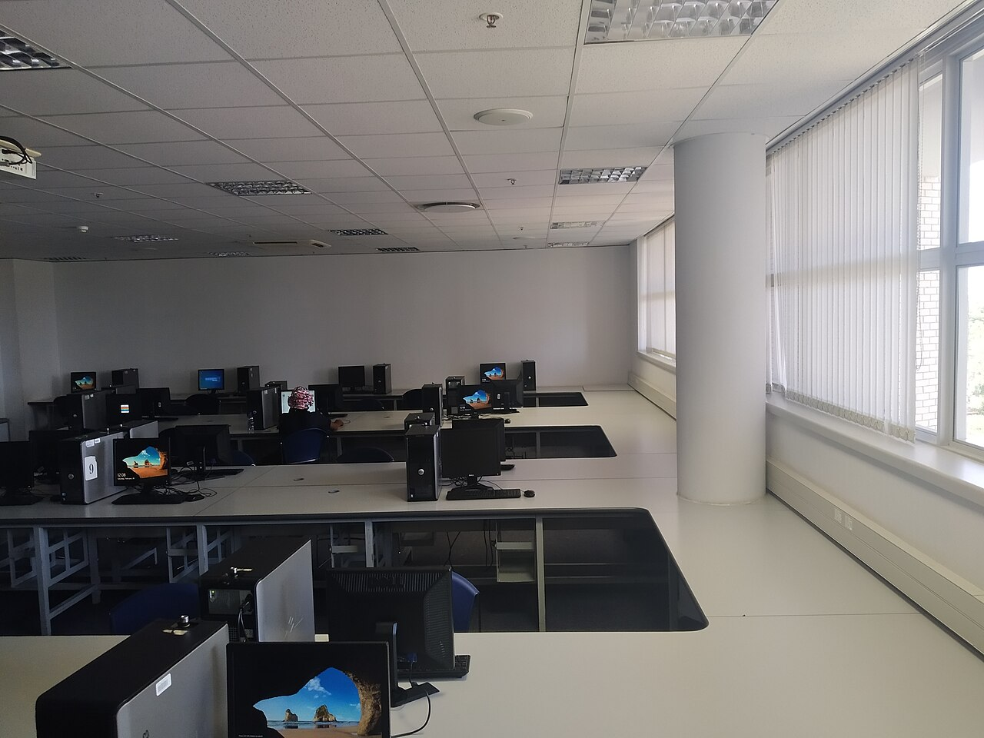
BIT 111: MICROCOMPUTERS AND APPLICATIONS | SOKOINE UNIVERSITY OF AGRICULTURE
Topic 4: Computer Science lab, at block 247 lab 293 at the University of Botswana.jpg
IMAGE NOTES
Description: Computer Science lab, at block 247 lab 293 at the University of Botswana
Creator: Sikolethu
License: CC BY-SA 4.0
Source: Wikimedia Commons file page
License details
BIT 111: Microcomputers and Applications | Instructor: Madam Bertha Msuliche Lebalwa (MSc) - SUA Morogoro
Slide 38 of 42

Slide 39
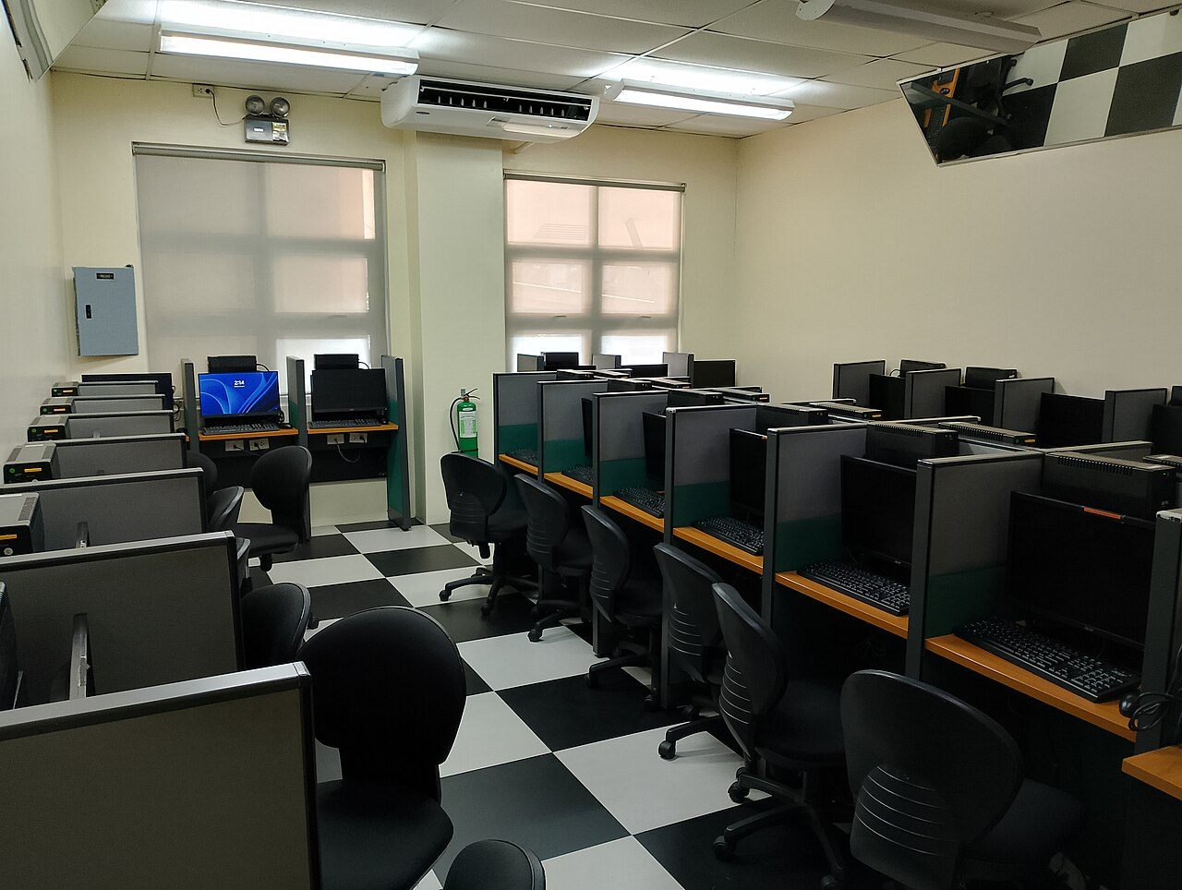
BIT 111: MICROCOMPUTERS AND APPLICATIONS | SOKOINE UNIVERSITY OF AGRICULTURE
Topic 4: De La Salle University – Dasmariñas (DLSU–D) Information and Communications Technology Center (ICTC) laboratory room 203 (ICT203) — normal view.jpg
IMAGE NOTES
Description: De La Salle University – Dasmariñas (DLSU–D) Information and Communications Technology Center (ICTC) laboratory room 203 (ICT203) — normal view
Creator: UndueMarmot
License: CC0
Source: Wikimedia Commons file page
License details
BIT 111: Microcomputers and Applications | Instructor: Madam Bertha Msuliche Lebalwa (MSc) - SUA Morogoro
Slide 39 of 42

Slide 40
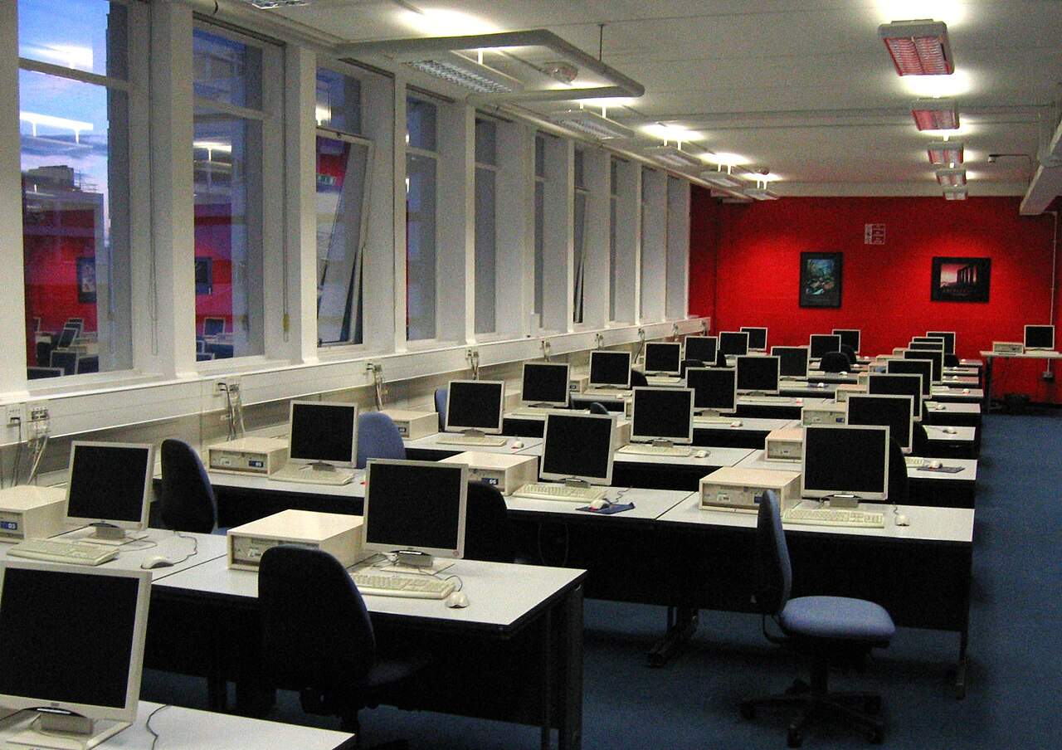
BIT 111: MICROCOMPUTERS AND APPLICATIONS | SOKOINE UNIVERSITY OF AGRICULTURE
Topic 4: Computer lab showing desktop PCs warwick.jpg
IMAGE NOTES
Description: Computer lab showing desktop PCs warwick
Creator: User Mike1024 on English Wikipedia
License: Public domain
Source: Wikimedia Commons file page
BIT 111: Microcomputers and Applications | Instructor: Madam Bertha Msuliche Lebalwa (MSc) - SUA Morogoro
Slide 40 of 42

Slide 41
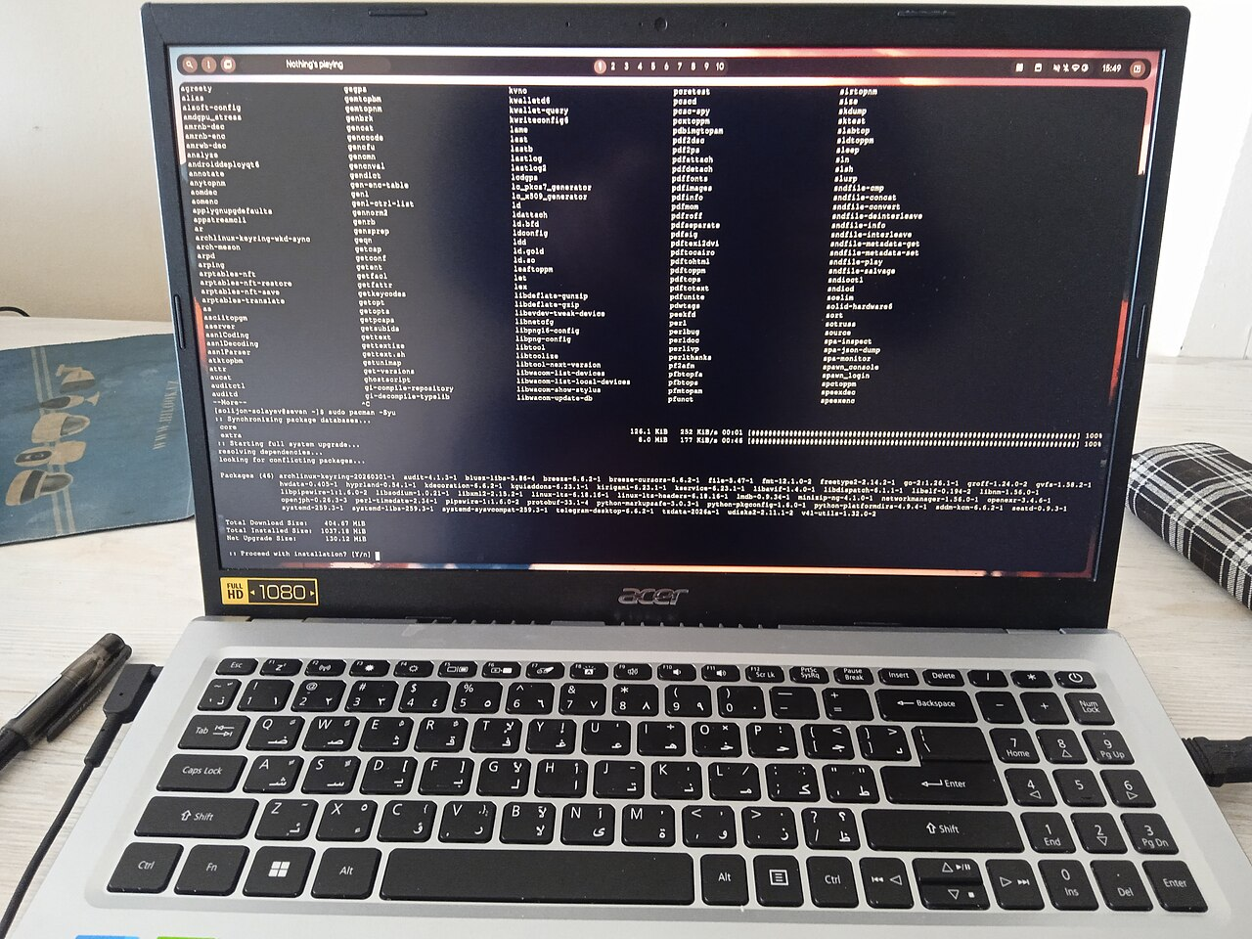
BIT 111: MICROCOMPUTERS AND APPLICATIONS | SOKOINE UNIVERSITY OF AGRICULTURE
Topic 4: Arch Linux system update via pacman on an Acer laptop.jpg
IMAGE NOTES
Description: Arch Linux system update via pacman on an Acer laptop
Creator: Solijon Solayev
License: CC BY-SA 4.0
Source: Wikimedia Commons file page
License details
BIT 111: Microcomputers and Applications | Instructor: Madam Bertha Msuliche Lebalwa (MSc) - SUA Morogoro
Slide 41 of 42

Slide 42
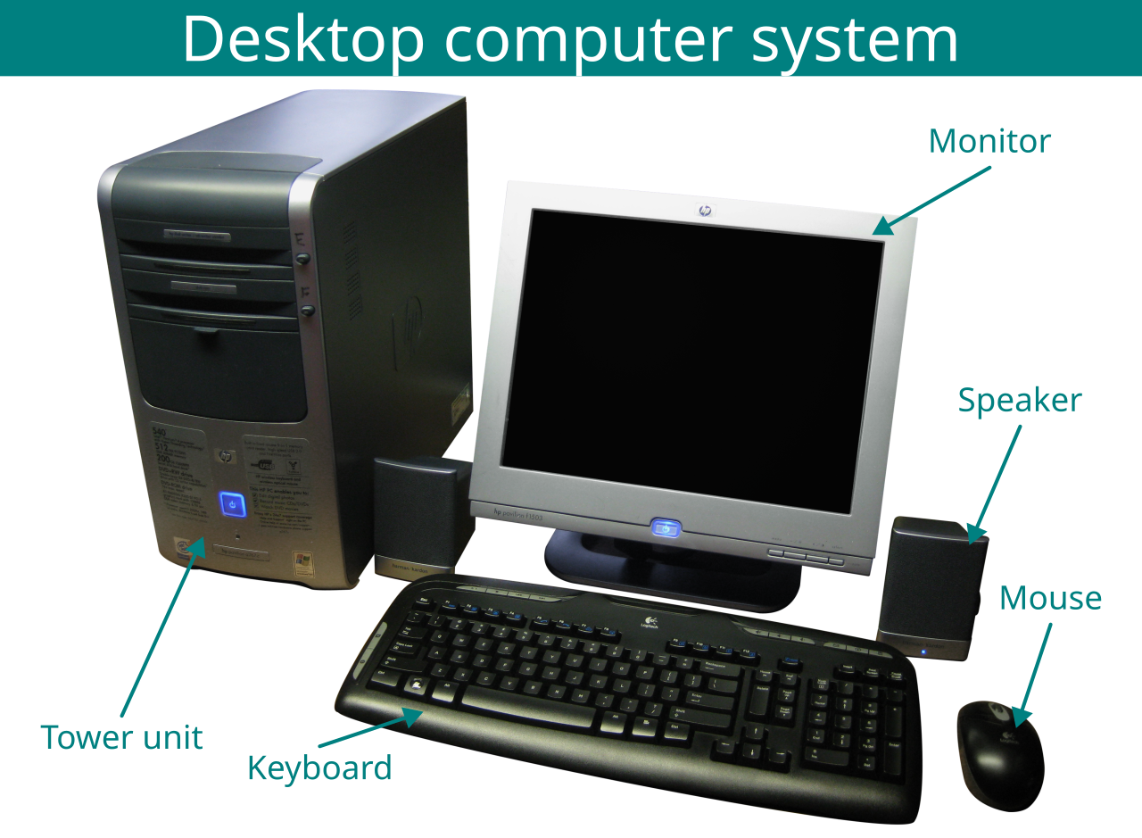
BIT 111: MICROCOMPUTERS AND APPLICATIONS | SOKOINE UNIVERSITY OF AGRICULTURE
Topic 4: Desktop computer system diagram (English).svg
IMAGE NOTES
Description: Desktop computer system diagram (English)
Creator: Photograph: kjarrett on Flickr
License: CC BY 2.0
Source: Wikimedia Commons file page
License details
BIT 111: Microcomputers and Applications | Instructor: Madam Bertha Msuliche Lebalwa (MSc) - SUA Morogoro
Slide 42 of 42

